Slide 1


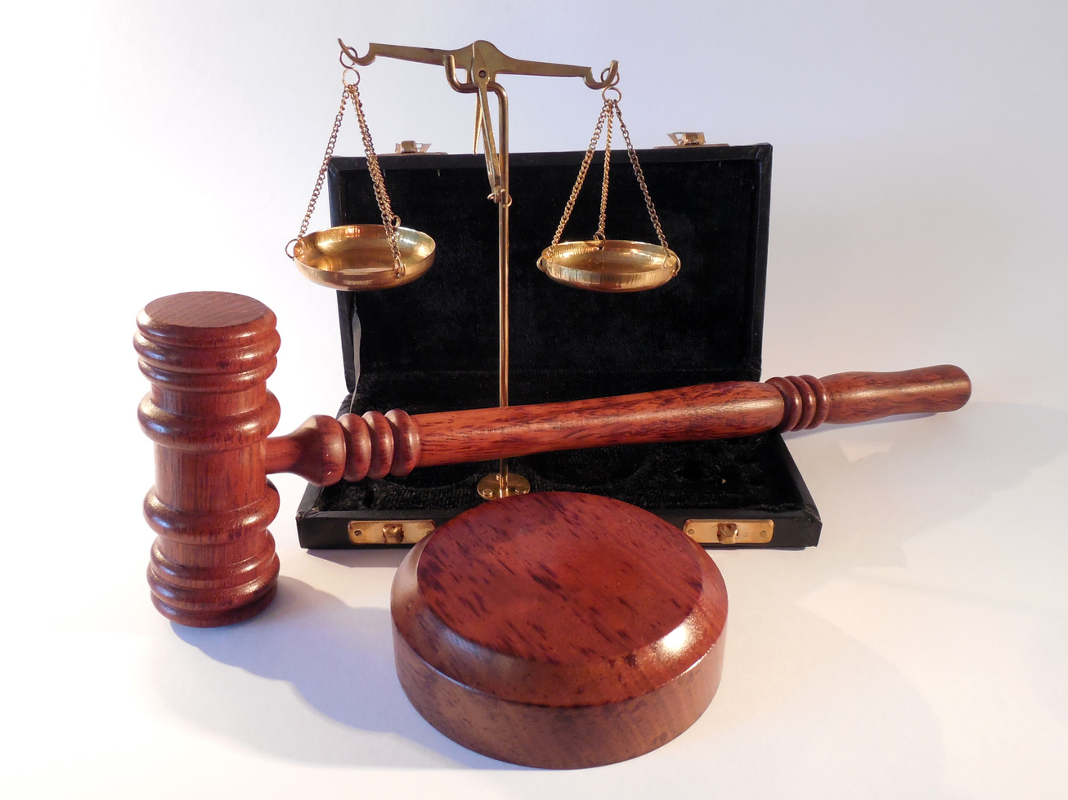
LEGAL INFORMATION MANAGEMENT
&
BRIEFING SYSTEM
Web-based Complete Solution for Litigation Management & Monitoring

Slide 2
LIMBS BACKGROUND
LIMBS is a simple and innovative web-based application which utilizes standard template with well-defined fields for storage, categorization and search of legal cases and documents, managing timely administrative procedures and audit trail which in turn bring uniformity in office standard norms of entire chain of litigation management involving Union of India.
LIMBS brings together key stakeholders– including Users, Nodal Officers, Ministries/Departments, and Advocates– onto a single, unified platform for efficient case management.
PROGRESS OF LIMBS
53 Ministries
06 Apex/Independent Bodies
400+ Attached/ Subordinate offices/PSUs
13108 Registered Users
1281049 Total Cases
725262 Pending Cases

Slide 3

FEATURES OF LIMBS
Integrated with Supreme Court of India, High Courts, District & Session Courts and
9 Tribunals which enables real-time data retrieval on case details and court orders.
2. Auto-Update via CNR (Case number Record) : Ensures daily automated updates on
case status, hearing dates, and court orders
3. MIS Reports: User can generate 15 types of various reports e.g. Case status wise,
Case category, Financial implication, Court wise, Total report, Periodic Report,
Contempt cases / NDOH cases report.
4. Case search on basis of case details via Advanced Search
5. Marking of Important Cases by the Nodal officer & Local Admin.
6. SMS alerts on New user registration, Forgot password, NDOH and Transfer
of cases, weekly report SMS to the concerned Nodal Officer
Transfer of cases from one user to another registered user. When a user or a case has
been transferred from one department to another.
Provision of monitoring Arbitration, AMRD & AMRCD cases
Monitoring of financial Implication in terms of compensation-related matters
Add progress of the case can be captured.
E-mail alerts to the concerned Nodal officer.
Provision to upload document & affidavit.
Provision to link cases.
Provision to download the reports into Excel & PDF format.

Slide 4
BENEFITS OF LIMBS
Reduces dependency on physical file.
System generated SMS alerts for Next Date of Hearing, Disposed of cases and
weekly report SMS to the concerned Nodal Officer.
Auto-update of case details & order copies via API with court order
4. Monitoring at various stages of court cases- (Contempt, Ongoing, Decided)
Concurrent data monitoring of court cases by different stakeholder.
Single platform for all the stakeholders.
7. Monitoring age profile of court cases.
Provision of Multi-Ministry/Multi-Party cases.
Scattered information in one place
Advocate wise reports

Slide 5

HIERARCHY OF LIMBS
Nodal officer (JS and above)
(Ministry wise / Department wise)
Multiple local admin
Local admin
(Department wise)
Number of users (Ministry wise/ Department wise)
Number of users
(Sub-division wise)
Number of users (Autonomous bodies)
Local admin
(Department wise)

Slide 6

ROLE OF NODAL OFFICER
User Activation
User Profile updation
3. Marking of Important Cases.
4. Creation of Local Admin.
5. Monitoring of court cases of
concerned Ministry/Department.
Monitoring of Exception cases.
Monitoring cases not updated via CNR.
Provision to reset user password &
user ID of their concerned department.

Slide 7

ROLE OF LIMBS USER
New Case entry via data fetching from courts
2. Update the case status
(Ongoing , Contempt and Disposed-of)
3. Update the CNR (Case number record for
Supreme Court, High Court and District &
Session court cases) numbers.
4. Update the Tribunal cases Via API
5. Transfer of case (One user account to
other user account)
6. Generation of 15+ reports (CNR/Tribunal
Summary and MIS report)
7. Use of advance search to generate
customized reports.
8. Entry of Arbitration, AMRCD & AMRD cases.

Slide 8
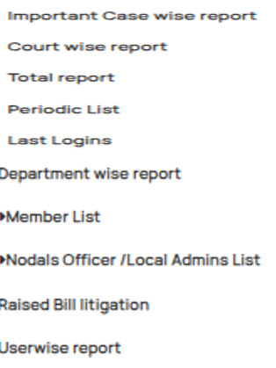
MIS REPORTS
Status wise report
Case Category wise report
Advocate wise report
Court wise report
Periodic wise report
Exception cases wise report
Financial Implication wise report
User wise report
Member wise report
Contempt/NDOH wise report
Last login wise report
Department wise report
Total cases report
Monthly report
Important case wise report

Slide 9
THANK YOU

