Slide 1
USER MANUAL https://limbs.gov.in

Slide 2
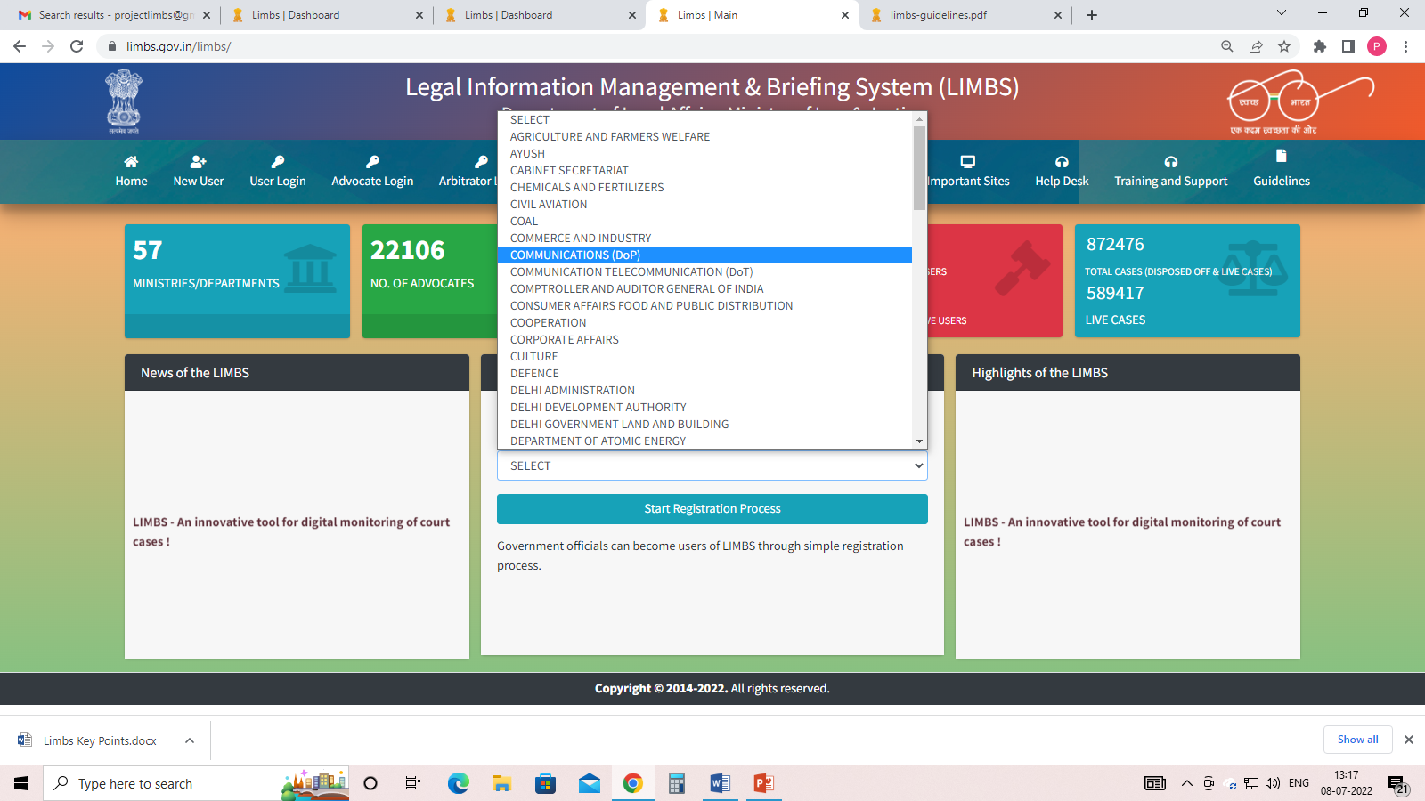
NEW USER REGISTRATION :
(The specific ministry would login with its username and password in the user login form)
STEPS OF NEW USER REGISTERATION:
Click on New user link
Select Ministry from the drop-down
Fill details as required (name, mobile number, designation, department/attached/subordinate office, username, password, confirm password, captcha )
Add User: Click on the ADD USER button to complete the registration process

Slide 3
POLICY TO FILL DETAILS
Name: Enter full name. It accepts only alphabets and space. Number and special characters are not allowed.
Mobile Number: Enter 10 digit mobile numbers.
Designation: Select designation from drop down list.
4. Department/Attached/Subordinate Office: Select department/attached/subordinate office from the drop list. Subsequently select sub-department and functional department (if available) from the drop down list.
5. Username: Length is between 5 to 15. It accepts only alphanumeric values.
6. Password: ◆ Password should be at least 8 characters long. ◆ It should contain at least one number, one alphabet , one special character , one upper case and one lowercase letter.
7. Add User: Click on the ADD USER button to complete the registration process
Note* For Activation of account can contact to LIMBS team on Legis@nic.in/Projectlimbs@gmail.com

Slide 4
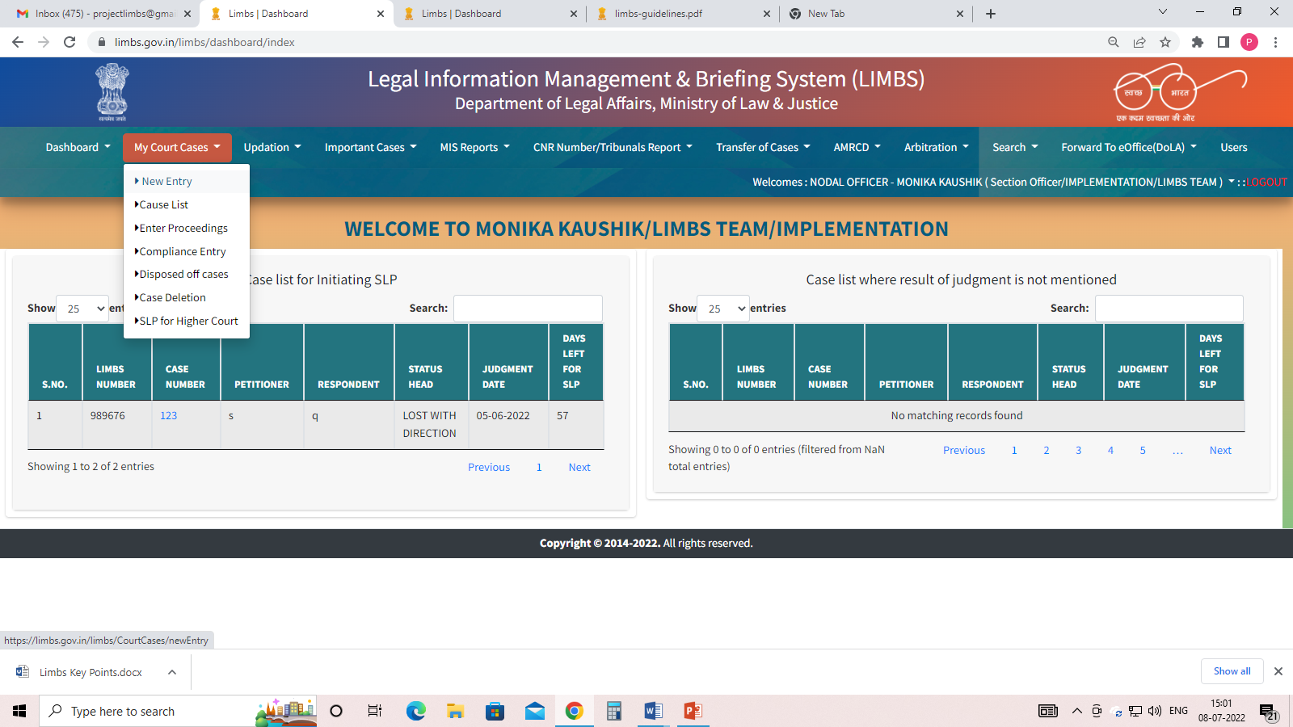
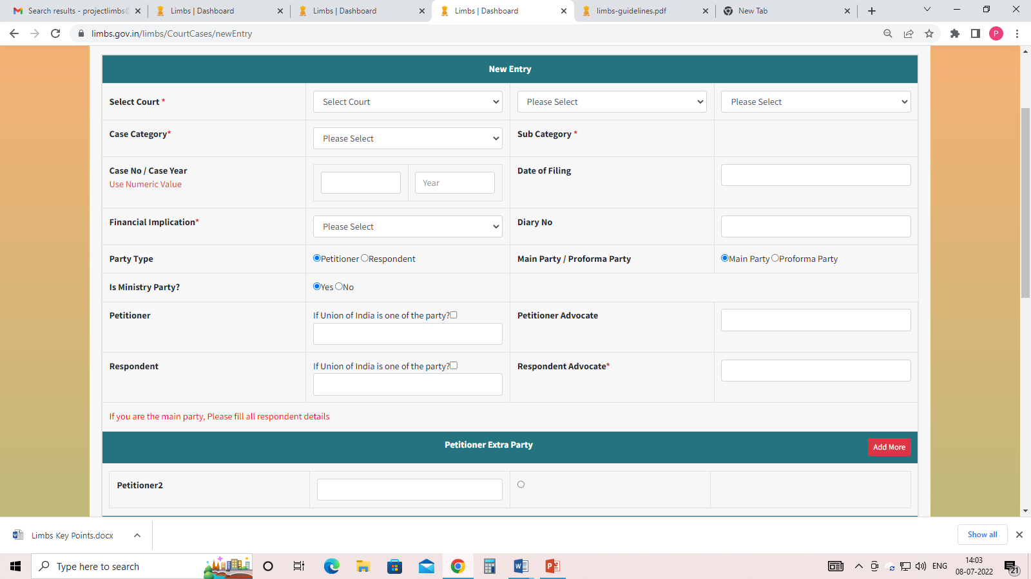
NEW CASE ENTRY
(via New Entry under My court cases)

Slide 5
POLICY TO FILL DETAILS
Select Court: Select appropriate court name from the drop down list.
CNR Number: Enter 16 digit unique CNR Number as mentioned in e-Courts website (for district court cases only).
Case No: Enter case no. Only digits are allowed. Special characters and alphabets are not allowed.
Case Date: Select date of filing from the calendar.
Registration Number/Year: Enter registration number/year as mentioned in e-Courts website (for district court cases only).
Registration Date: Enter registration date as mentioned in e-Courts website (for district court cases only).
Case Category and Sub Category: Select appropriate case category and sub category from the drop down list.
Financial Implication: Select appropriate financial implication from the drop down list. ★ Diary No: Enter correct diary no.
Party Type: Select correct party type (either Petitioner or Respondent)
Petitioner: Enter petitioner name. It accepts alphabets, numbers and special characters.
Petitioner Advocate: Enter petitioner advocate name from the drop down only

Slide 6
POLICY TO FILL DETAILS
Respondent: Enter respondent name. It accepts alphabets, numbers and special characters.
Respondent Advocate: Enter respondent advocate name.
Under Act(s): Enter act name.
Under Section(s): Enter section number.
Brief History: Enter brief history of the case. It accepts alphabets, numbers and special characters.
Concerned Officer Name: Enter concerned officer name. It accepts only alphabets.
Concerned Officer Mobile Number: Enter concerned officer mobile number. Only 10 digit numbers are allowed.
Case Hearing: Enter correct case hearing details. Business date is last hearing date and Hearing date is the next hearing date. ★
Save: Press Save button to save the details of the case. ★ A 6 digit LIMBS number will be generated automatically.

Slide 7
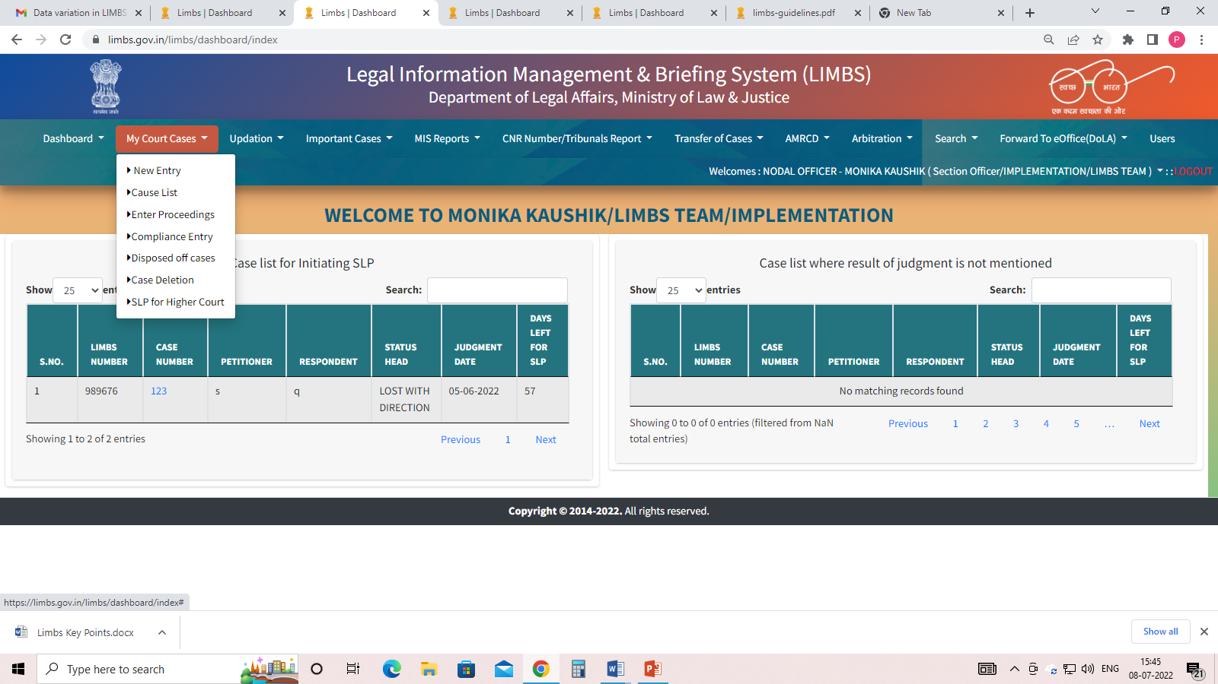
HOW TO UPDATE THE STATUS OF THE CASE:
(can update via Compliance entry & Enter proceedings )
Compliance entry :Used to update
the next date of hearing of the case.
Enter proceedings : Used to update
the last date of hearing of the case.

Slide 8
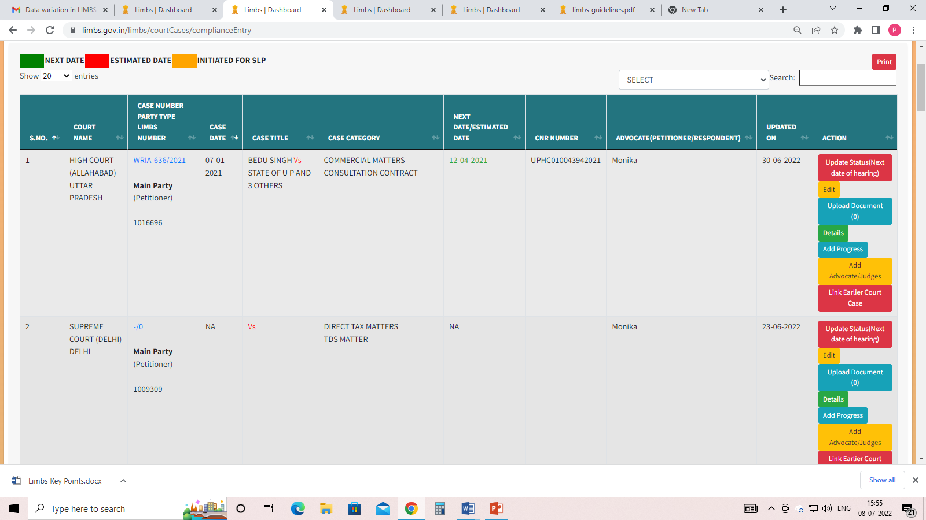
COMPLIANCE ENTRY
(List of cases entered from respective user’s account will be visible. Users can update the status of the case, can upload any document and can see details of the case)
Update Status Users can update the status of any case by clicking on Update Status link.
Edit to change in any existing information
Upload Document to upload any document
Details to view one page summary of the case
Add progress to mention any internal remarks
Add Advocate/Judges for more than two Advocate /Judge
Link earlier court cases for linking of cases

Slide 9
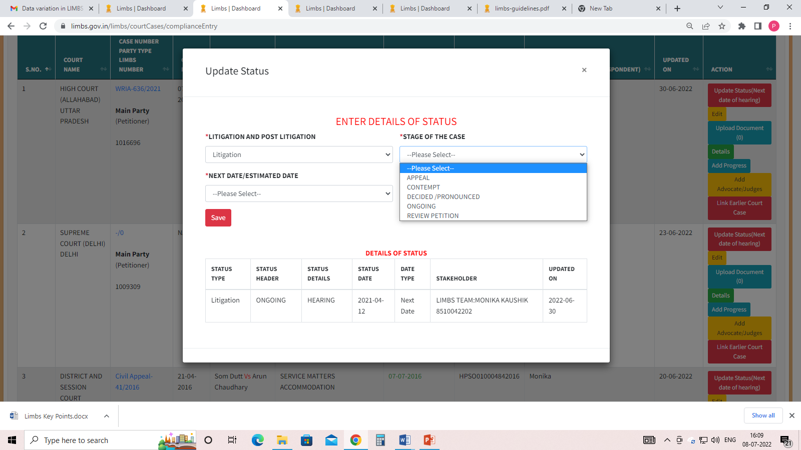
STATUS FOR ONGOING CASES
Choose litigation from the drop down
Select status as per the giving drop down (Appeal, Contempt, Decided/Pronounced, Ongoing and Review petition)
Select next date/ estimated date from calendar

Slide 10
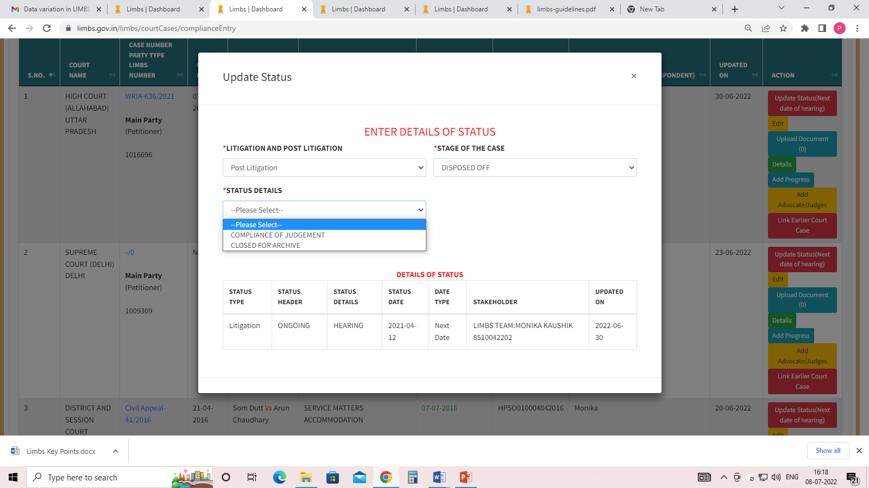
STATUS FOR DISPOSED OF CASES
Select Litigation -> Decided/Pronounced -> and then select Decided-Won/Lost/With Direction/ Dismissed. Then provide a judgement date and click on the Save button.
Select Post Litigation-> Disposed of ->Closed for Archieve and click on the save button
The case will automatically move from live cases list (Compliance) entry to Disposed of cases list under My court cases

Slide 11
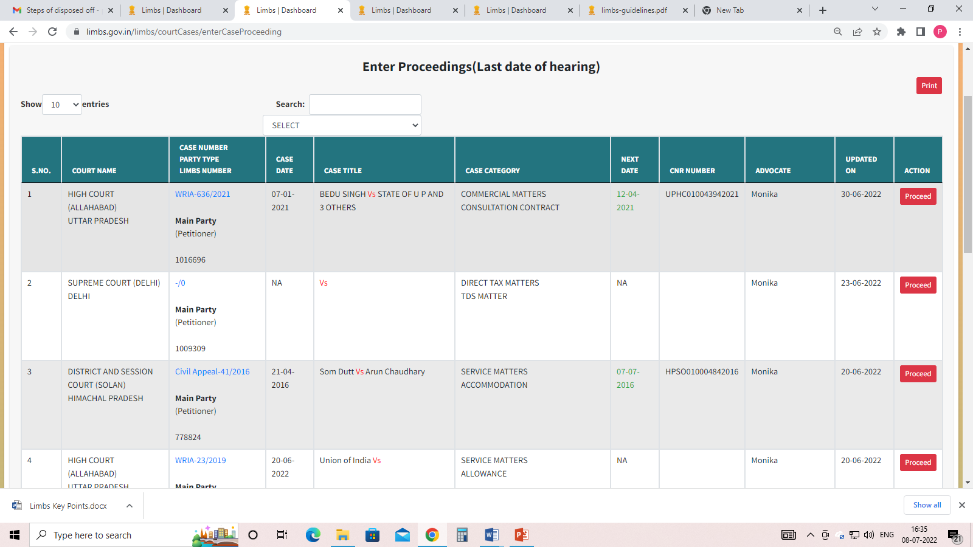
ENTER PROCEEDINGS
Click on My Court Cases -> Enter Proceedings to enter details of last hearing.
Click on Proceed button of the particular case in which
last hearing details is to be entered.
Enter all last hearing details and click on Submit button
to save the details.

Slide 12
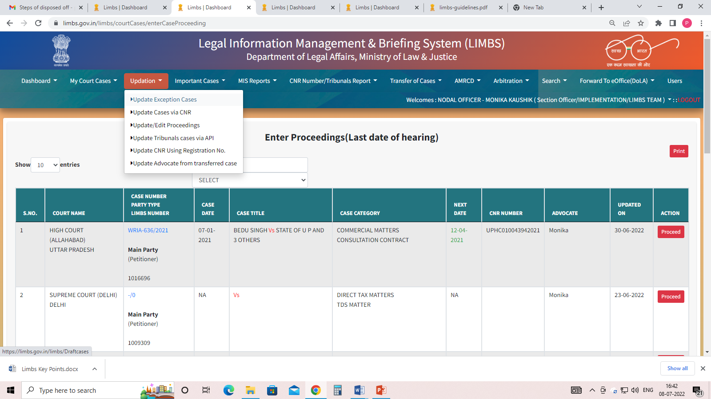
UPDATION
(user can update exception, CNR , Tribunal cases )
Click on the link named as “Update Exception Cases”
After click on the link of ‘Exception Cases’ one can see
the exception types.
➢ Court
➢ Case category
➢ Status
➢ Financial Implication
➢ Advocate
➢ Case date
➢ Next hearing date
➢ Last hearing date
III. To remove any type of “Exception”- click on the blue
“UPDATE” button fill details as required and “Save”

Slide 13
UPDATION
(CNR , Tribunal cases )
Click on the link named as “Update CNR using registration No.
Click on "view" button against HC and Distt. & Session court,
Simply a window of the Registration no, Registration Year, Case type (of court) will open,
fill all details, click on “Search” to find out CNR number.
Click on “view” to save updated information on LIMBS.
Updated CNR cases visible under CNR Number/Tribunals report

Slide 14
UPDATION
(Tribunal cases )
Click on the link named as “Update Tribunals cases via API
Click on "view" button against Tribunal court,
Simply a window of the Registration no, Registration Year, Name/Bench/Circuit, Case type (of court) will open,
fill all details, click on “Search” to find out updated information.
Click on “view” to save updated information on LIMBS.
Updated Tribunal cases visible under CNR Number/Tribunals report

Slide 15
UPDATION
(Tribunal cases )
Click on the link named as “Update Tribunals cases via API
Click on "view" button against Tribunal court,
Simply a window of the Registration no, Registration Year, Name/Bench/Circuit, Case type (of court) will open,
fill all details, click on “Search” to find out updated information.
Click on “view” to save updated information on LIMBS.
Updated Tribunal cases visible under CNR Number/Tribunals report

Slide 16
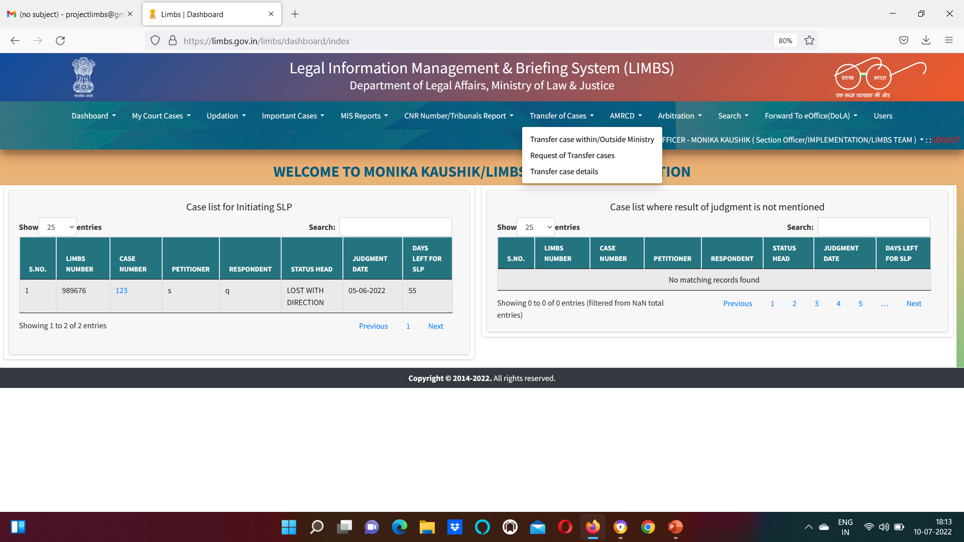
TRANSFER OF CASES
(Transfer Cases Within/ Other Ministry )
Users may transfer his/her cases to any user (registered LIMBS user of his/her ministry).User also have provision to Pull Back cases.
Another user also have provision to Accept/Reject those cases.
User also has a provision to view transferred cases

Slide 17
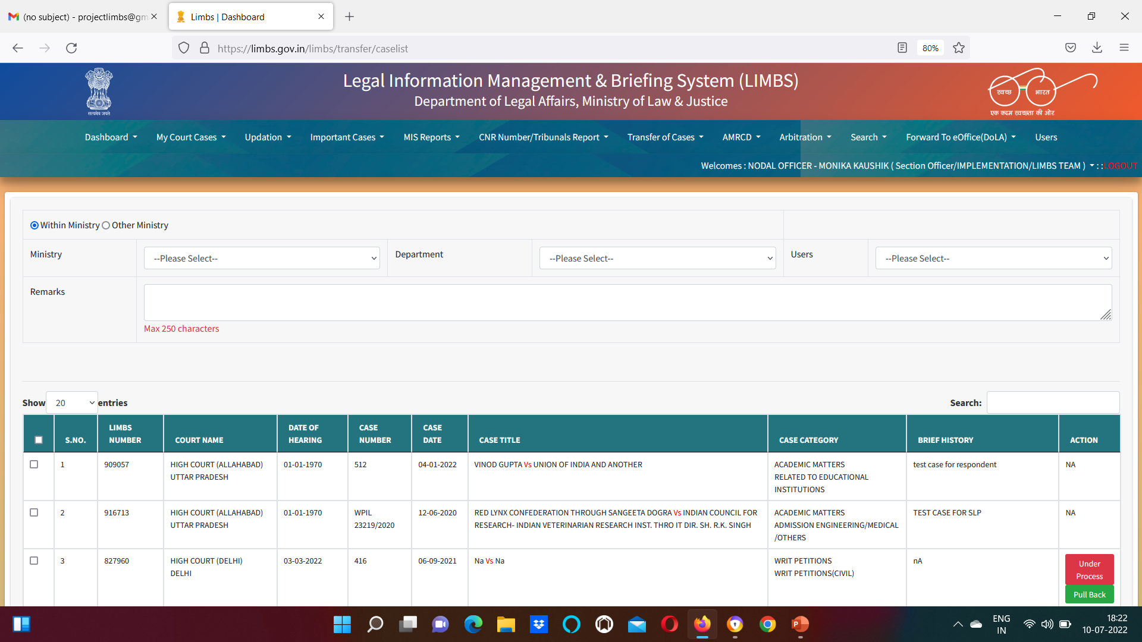
TRANSFER OF CASES
(Transfer Cases Within/ Other Ministry )
Select name of the user from the drop down -> put your remarks -> Go down and click on transfer of cases
User will receive a SMS on his/her mobile number with user/case details

Slide 18
MIS REPORTS
USERS CAN VIEW STATISTICAL REPORTS OR SUMMARY REPORTS
viz.
Case status wise summary
Case category wise summary
Financial implication wise summary
Important case wise summary
Court wise summary
Decided cases summary
Total report
Total member list
List of Nodal/Local
Raised bill summary
etc.

Slide 19
